Slide 1

ميراث المؤمن
تحذير في العبرانيين
علم الخلاص : برنامج الله الخلاصي
د. ريك جريفيث• مؤسسة الدراسات اللاهوتية الأردنية• BibleStudyDownloads.org
Notes:
Here is Part 3 of the 4-part study on The Inheritance of the Believer.

Slide 2
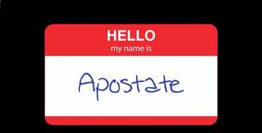
المرتدون لا يرتدون علامات الأسماء
Notes:
I guess that you have never seen a nametag like this.
• That’s because apostates don’t wear nametags.

Slide 3

المرتدون يدمرون من الداخل
الرجال الذين دمروا الغرب المسيحي
Notes:
Believers have failed to fight apostasy for the past 200+ years.
• Apostates are believers who turn away from Christ and yet live among the saints and destroy the church within. This has happened significantly in what used to be called the "Christian West."

Slide 4
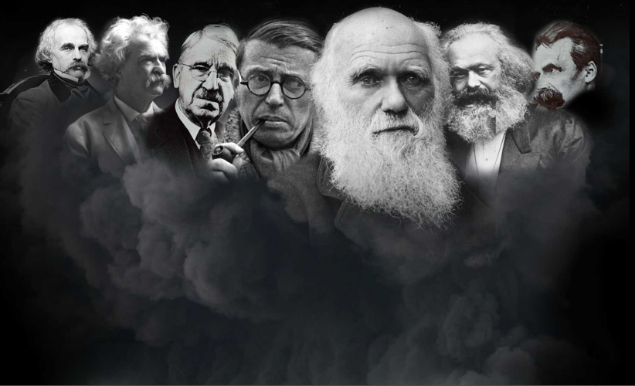
من هم المرتدون ؟
تشارلز داروين
نثنائيل هوثورن
جون ديوي
فردريك نيتشه
مارك توين
كارل ماركس
جين – بول سارتر
آرنست همنغواي
ليدي غاغا
Notes:
This includes many well-known men of the past—and even moderns like Ernest Hemingway and Lady Gaga. One thing they all have in common is that they all grew up in Christian homes but later turned away from the faith. The word “apostate” means to turn away so they originally trusted in Christ but then turned away. Notice that none of them smile.

Slide 5
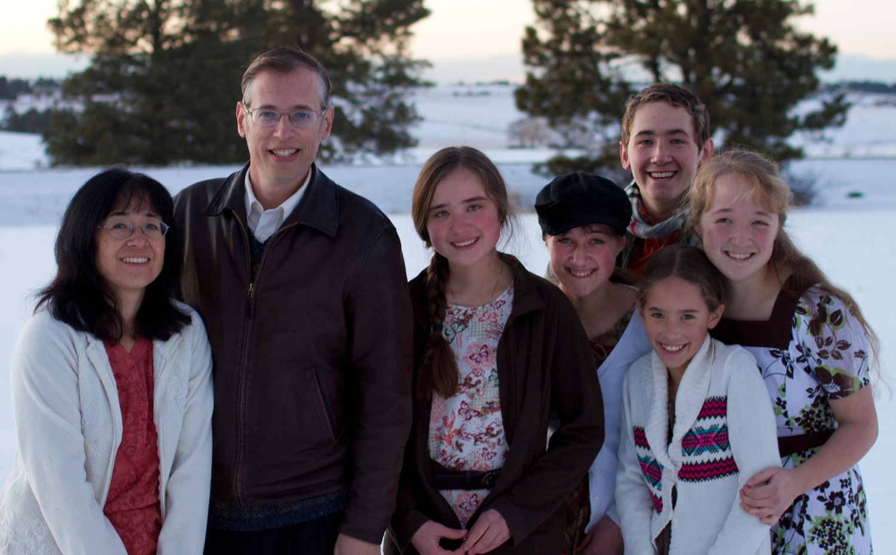
كتاب المرتد
كيفين سوانسون و عائلته
Notes:
Kevin Swanson chronicles the history of Western apostasy in his book called Apostate.

Slide 6

لماذا هم مهمون ؟
هذه قصة انحدار وسقوط الحضارة الغربية. إنها قصة رجال أقوياء غير مألوفين ، رجال
أشرار لا يسبر غورهم. . . المرتدون
كيفين سوانسون

Slide 7
ماذا يعلم
المرتدون ؟
تشارلز داروين
نثنائيل هوثورن
جون ديوي
فردريك
نيتشه
مارك توين
كارل ماركس
جين – بول
سارتر
إزالة التعليم في المنزل
لا يوجد إله
الله لم يخلق
نحن تطورنا
Notes:
• John Dewey founded the US public education system to eliminate home schools.
• Darwin convinced the world to believe in evolution instead of creation.
• And Marx was an atheist.

Slide 8
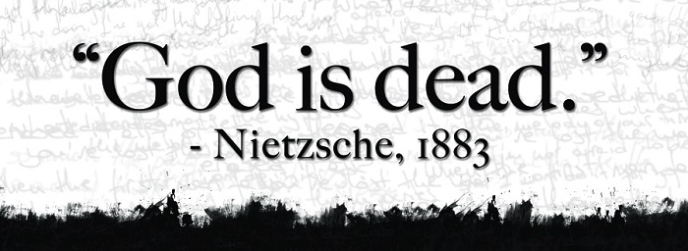
فلسفة إلحادية
"الله ميت"
نيتشه، 1883
"نيتشه ميت"
الله، 1900
Used with permission
Notes:
Nietzsche popularized the saying, “God is dead” in 1883.
• But God responded 17 years later, “Nietzsche is dead.”

Slide 9

روب بيل و أوبرا وينفري
Notes:
Modern apostates who also grew up in Christian homes include Rob Bell (author of Love Wins, a universalist book), and Oprah Winfrey—the most popular apostate in the world as the most influential woman who teaches the same belief that all are saved.

Slide 10
ميراث المؤمن
تحذير في العبرانيين
علم الخلاص : برنامج الله الخلاصي
د. ريك جريفيث• مؤسسة الدراسات اللاهوتية الأردنية• BibleStudyDownloads.org
Notes:
Here is Part 3 of the 4-part study on The Inheritance of the Believer.

Slide 11

الخلاص بالإيمان لكن
المكافآت بالأعمال
الفكرة الرئيسية
Notes:
This is message 3 of my 4-part series on the Inheritance of the Believer. In the first message, we saw this key truth: We come into a right relationship with God by placing our trust in Christ—but that is just the beginning as we need to obey him to be fully blessed (MI restated).
Then, the second message concluded that…

Slide 12

خلاصنا مضمون لكن المنشقين يخسرون المكافآت
الفكرة الرئيسية
Notes:
The Bible teaches both assurance and apostasy—so believers can lose rewards but not salvation (MI restated).

Slide 13
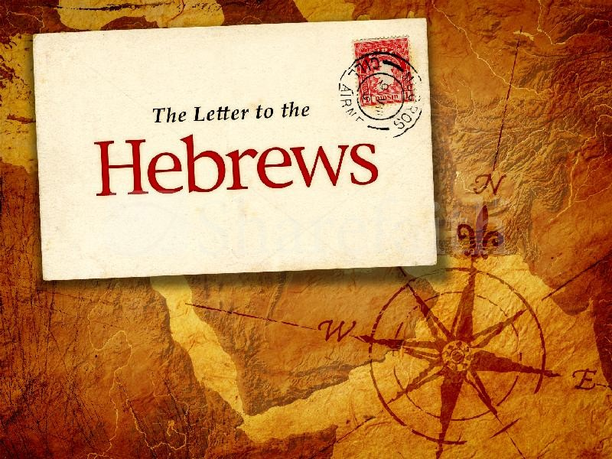

العبرانيين
الرسالة إلى
Notes:
Today we will see that the book of Hebrews warns Jewish believers from apostasy—do you know what they are warned about?

Slide 14
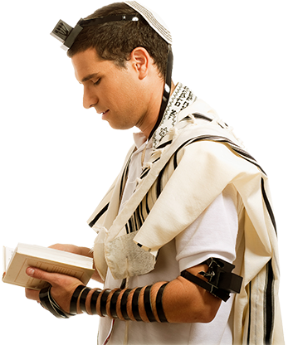
كيف نعرف أن القراء كانوا يهوداً ؟
Notes:
The whole book assumes they know the OT law and sacrifices.

Slide 15
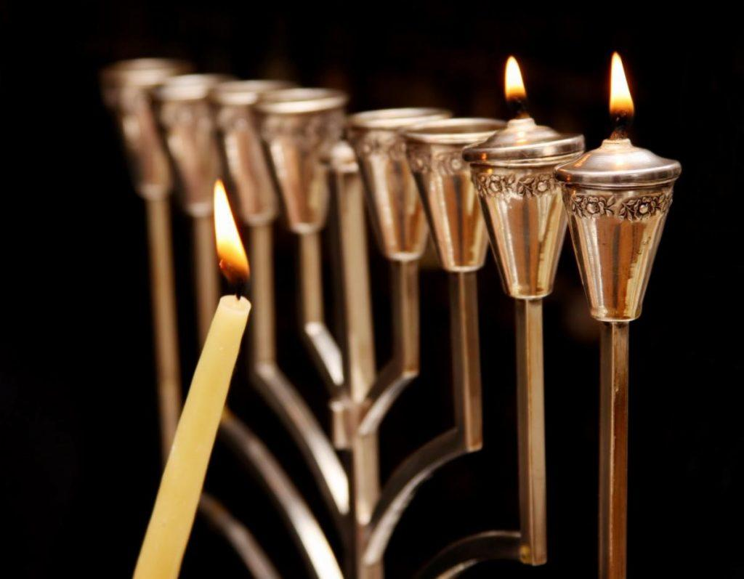
كان القراء يهوداً مسيحيين
من ثم أيها الإخوة القديسون شركاء الدعوة السماوية (3: 1)
فلنتمسك بالإقرار لأن ليس لنا رئيس كهنة غير قادر أن يرثي لضعفاتنا (4: 14ب-15أ)
فإذ لنا أيها الإخوة ثقة بالدخول إلى الأقداس بدم يسوع (10: 19)
و لكن تذكروا الأيام السالفة التي فيها بعدما أنرتم صبرتم على مجاهدة آلام كثيرة (10: 32)
Notes:
We also know the readers were Christians. These are clearly believers—why else would he repeatedly call them "brothers and sisters"? These Jews were second-generation (2:1-4) believers (3:1; 4:14b-15a; 10:19, 32; cf. 12:7; 13:1, 20-22) who should have matured beyond their present immature state in Christ (5:11-14)

Slide 16
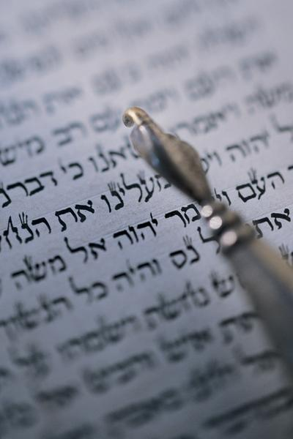
هل يجب علي أن ارجع ؟
لذلك يجب أن ننتبه أكثر إلى ما سمعنا لئلا نفوته
(2: 1)
Notes:
These believing Jews were undergoing so much difficulty that they were considering a return to Judaism—a temptation to turn away or turn back to their Jewish roots.

Slide 17
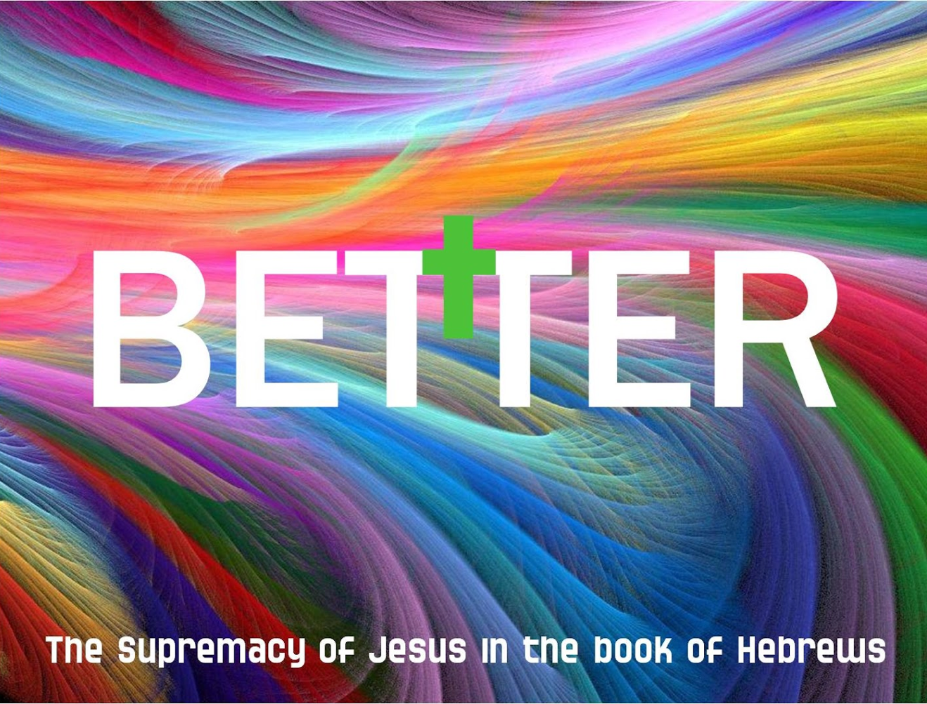
سمو المسيح في سفر العبرانيين
Notes:
So the writer sought to convince them that Jesus is better than anything they ever experienced in Judaism.

Slide 18
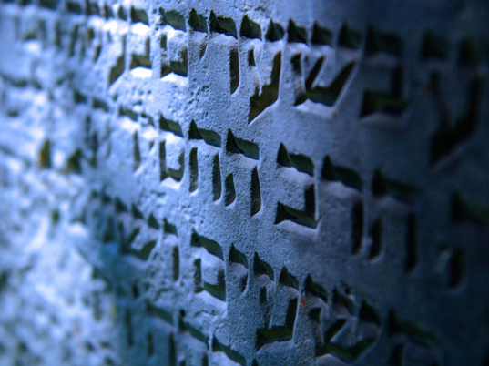
سفر ما هو أفضل
استخدم سفر العبرانيين كلمة أفضل 13 مرة
266ف
1: 4 المسيح أعظم من الملائكة
6: 9 و لكننا قد تيقنا من جهتكم أيها ألحباء أموراً أفضل
7: 7 ملكيصادق أفضل (أعظم) من إبراهيم
7: 19 يصير إدخال رجاء أفضل
7: 22 صار يسوع ضامناً لعهد أفضل
8: 6 المسيح وسيط عهد أعظم
8: 6 عهد جديد تثبت على مواعيد أفضل
9: 23 الملابس الكهنوتية تتطلب ذبائح أفضل
10: 34 مالاً أفضل في السماوات و باقياً
11: 16 السماء وطناً أفضل
11: 35 لكي ينالوا قيامة أفضل
11: 40 سبق الله فنظر لنا شيئاً أفضل
12:24 Christ's blood is "better than the blood of Abel“
12: 24 دم المسيح أفضل من دم هابيل
ملاحظة :
11: 4 قدم هابيل ذبيحة أفضل استخدمت كلمة يونانية مختلفة عادة ما تترجم أفضل
Notes:
The writer repeatedly told them not to reject the superior NT walk with Jesus for the inferior OT law.

Slide 19
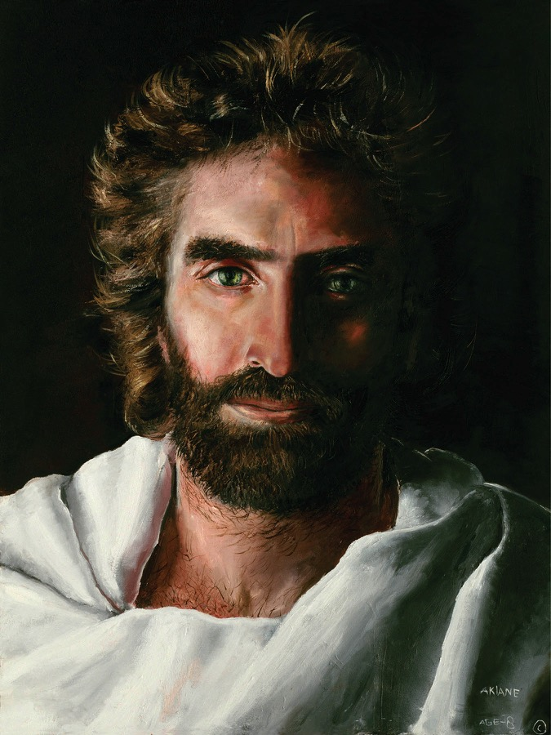
المسيح متفوق
في شخصه
(1: 1-4: 13)
Notes:
The first movement of the book notes that Christ is superior in his person to anyone in the OT.

Slide 20
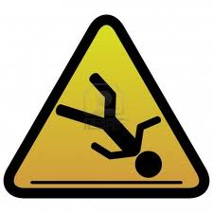
5 تحذيرات في العبرانيين
258
1. تحذير من الإنجراف بعيداً عن الحق (2: 1-4)
2. تحذير من عدم الإيمان (3: 7-19)
3. تحذير من عدم النضج (5: 11-6: 12)
4. تحذير من الخطايا المتعمدة (10: 19-39)
5. تحذير من اللامبالاة (12: 14-29)
سنرى اليوم تحذيرين أساسيين في العبرانيين عن الإرتداد
Notes:
Spread throughout the letter are FIVE dire admonitions not to apostatize (read them).
• Subject: Today we will see two key warnings from Hebrews about apostasy.
There are 5 warnings in total.
But we do not have time for all 5 today.
Preview: We will look only at Warning 3 and Warning 4.
Text: These are the two most controversial texts in Hebrews—and probably the whole NT.

Slide 21

تحذير 1
التخلي عن المسيح
ياتي بالتأديب
(2: 1-4)
Notes:
Turning our backs on Christ makes God have to turn up the heat in our lives.

Slide 22
تحذير 2
التخلي عن يسوع
يجلب التأديب
(2: 1-4)
Notes:
Turning our backs on Christ disinherits us from our millennial reign with Christ.

Slide 23
تحذير 3
رفض المسيح قد يؤدي إلى
الموت الجسدي
(5: 11-6: 20)
Notes:
Christians who later reject Jesus can die before their time

Slide 24
تحذير 4
خطايا العمد قد تؤدي إلى
الموت الجسدي
(10: 26-31).
Notes:
Christians with willful sin Jesus can die before their time

Slide 25
تحذير 5
رفض الله له
عواقب
(12: 25-29).
Notes:
Ignore the Lord and you will experience his discipline rather than his grace.

Slide 26
تحذير 3
رفض المسيح قد يؤدي إلى
الموت الجسدي
(5: 11-6: 20).
Notes:
Christians who later reject Jesus can die before their time

Slide 27

استحالة (عب 6: 4-6)
لأن الذين استنيروا مرة و ذاقوا الموهبة السماوية و صاروا شركاء الروح القدس و ذاقوا كلمة الله الصالحة و قوات الدهر الآتي و سقطوا لا يمكن تجديدهم أيضاً للتوبة إذ هم يصلبون لأنفسهم ابن الله ثانية و يشهرونه
Notes:
Too often we read this as if it says, “For it is impossible to bring back to SALVATION…”
But it doesn’t say “SALVATION.” It says “REPENTANCE” and no one can be brought BACK to repentance unless he has already FIRST repented, right? This text refers to Christians!

Slide 28
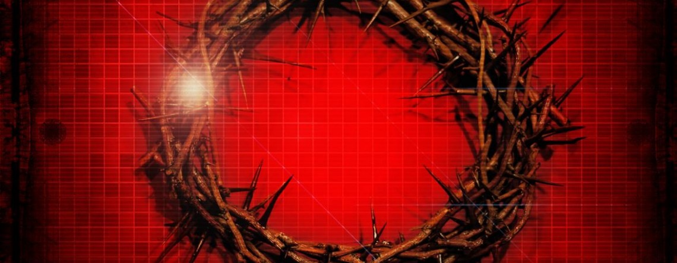
لا يمكن التوبة عن الإرتداد لأنك ستكون ميتاً
(عب 6: 4-8)

Slide 29
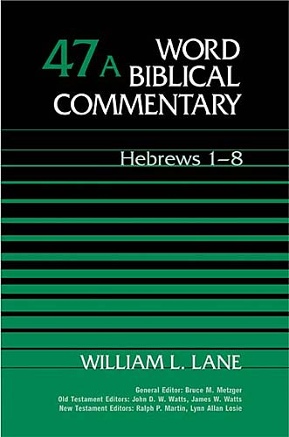
هل سيذهب بعض المؤمنين إلى جهنم ؟
Notes:
The two-volume massive commentary series by William Lane addresses questions relevant to us all.

Slide 30
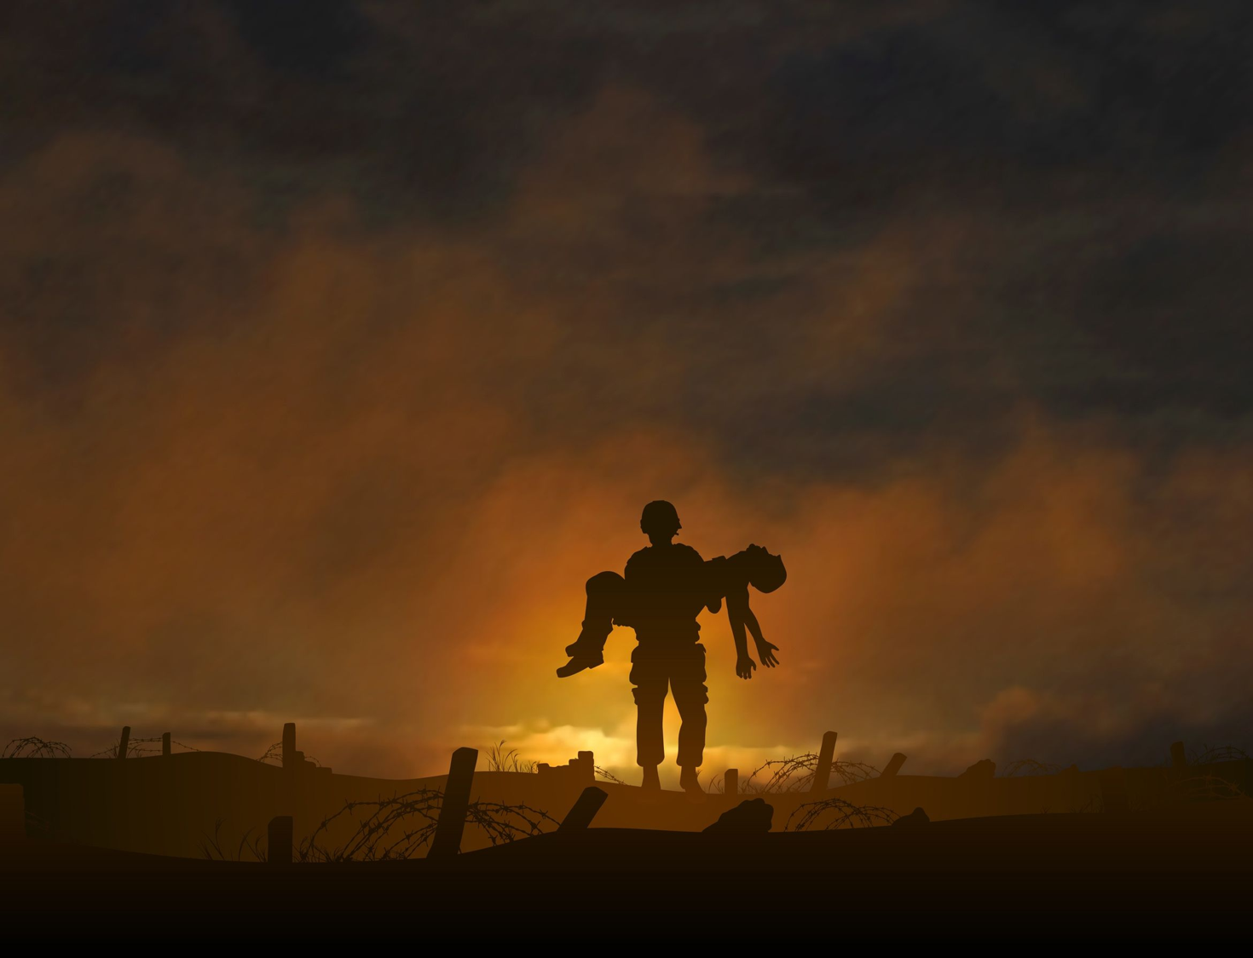
ما هو الخطر في 6: 4-8 ؟
1. المؤمن المسيحي الذي يفقد خلاصه ؟
2. فرضية حالة مستحيلة لا يمكن أن تحدث
3. اعتراف غير أصيل من البداية يؤدي إلى جهنم
4. مؤمن غير مؤهل للخدمة المسيحية و لن يعود مطلقاً للإلتزام الروحي و الموت هو الدليل القاطع

Slide 31


أعتقد أن القراء عاشوا في إسرائيل
256
رومية
إسرائيل

Slide 32
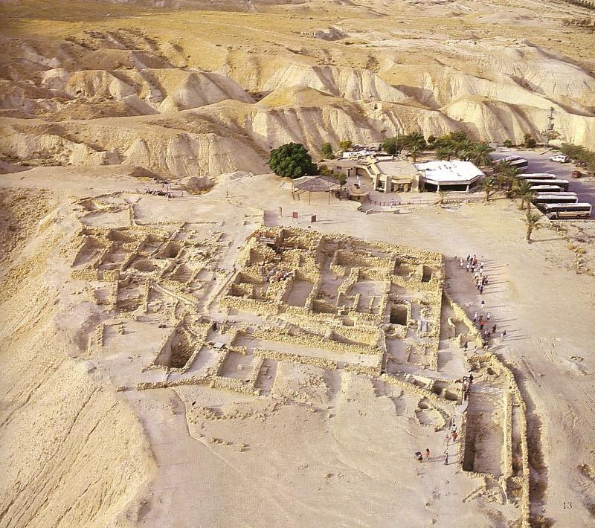

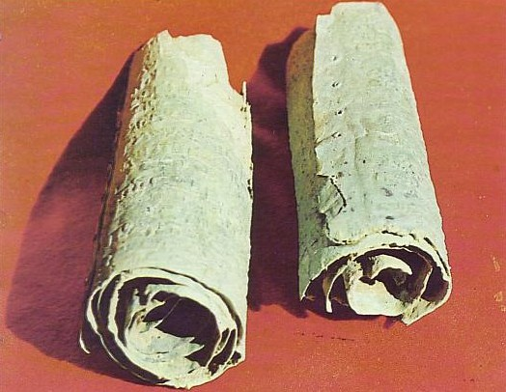
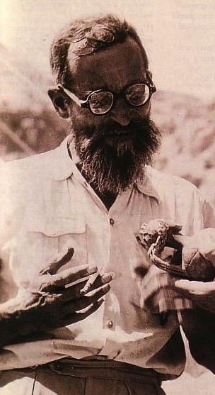
أطلال قمران
De Vaux
Notes:
Maybe they were even from a secluded community like Qumran.
• Excavated by Roland De Vaux

Slide 33

إسرائيل
(67-68 م)
أورشليم
Notes:
During the Jewish Revolt of AD 66-73, all the Jews—believers and unbelievers alike—found refuge in Jerusalem against the Roman armies.

Slide 34

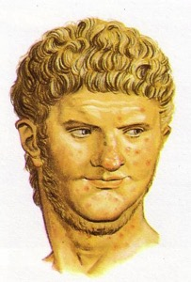
الحرب اليهودية (66-73 م)
257
تدنيس قيصرية
تمرد أورشليم
توةقف تقديم الذبائح لنيرون في الهيكل
روما ترسل فاسباسيان
موت نيرون
حصار أورشليم من قبل تيطس (نيسان-أيلول 70)
Notes:
The various events of AD 66-70 led to Titus sieging the capital.

Slide 35


حصار سور أورشليم (70 م)
يشير يوسيفوس إلى أن جدار الحصار أحاط بالمدينة بأكملها بما في ذلك قبر حنان الواقع بين مقابر اكيلداما. هذا يدعم كونها مكان دفن ثري (وليس حقل الفخاري)
Leen & Kathleen Ritmeyer, "Akeldama: Potter's Field or High Priest's Tomb?" BAR 20 (Nov/Dec 94): 34
Notes:
The Romans built a siege wall to protect their troops from marauding Jewish fanatical defenders who left the city at night to attack the Roman troops.

Slide 36
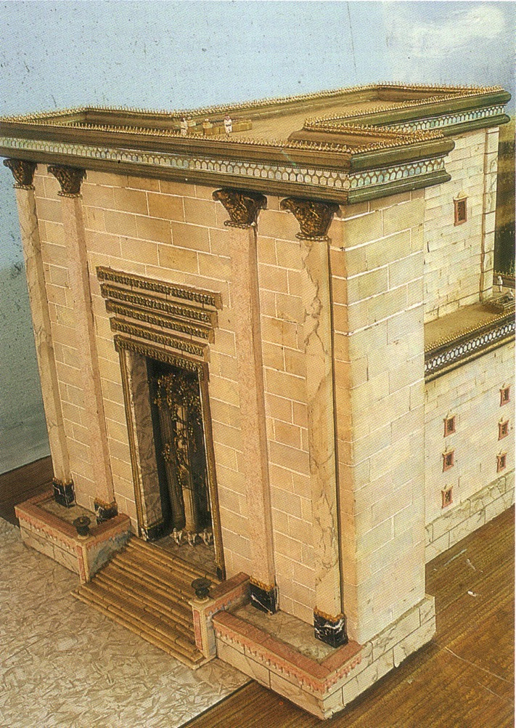
حرم الهيكل
Notes:
The temple had stood for almost 600 years.
This Second Temple had just been completed in AD 64 but Jesus said that not one of its stones would remain on another (Matt 24:2).

Slide 37
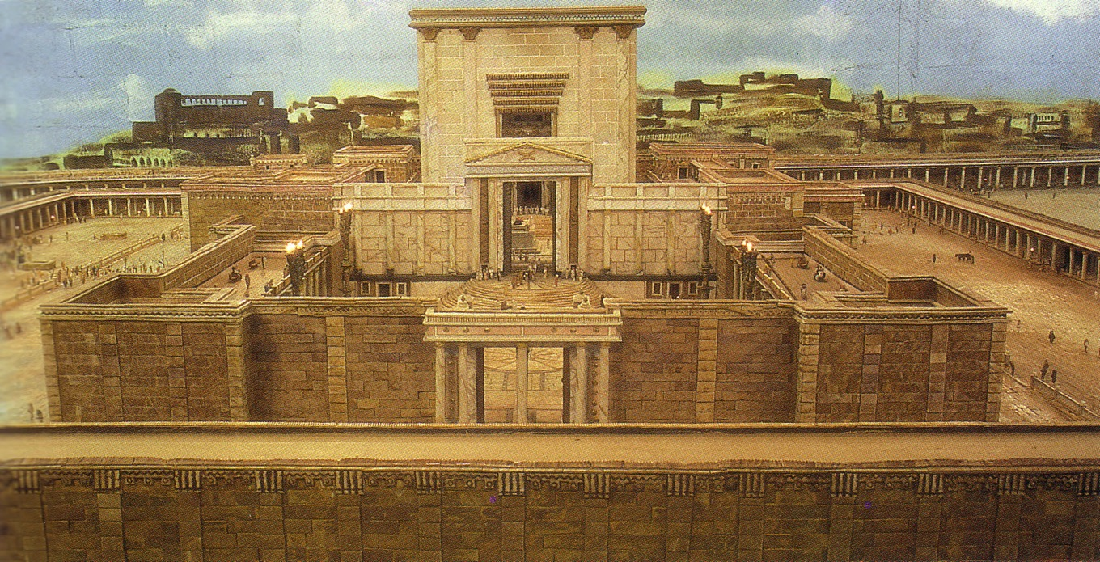
الهيكل من الشرق
Notes:
The temple was a massive complex that ended up being the last part of the city for the Jews to defend. Was this temple worth defending?

Slide 38
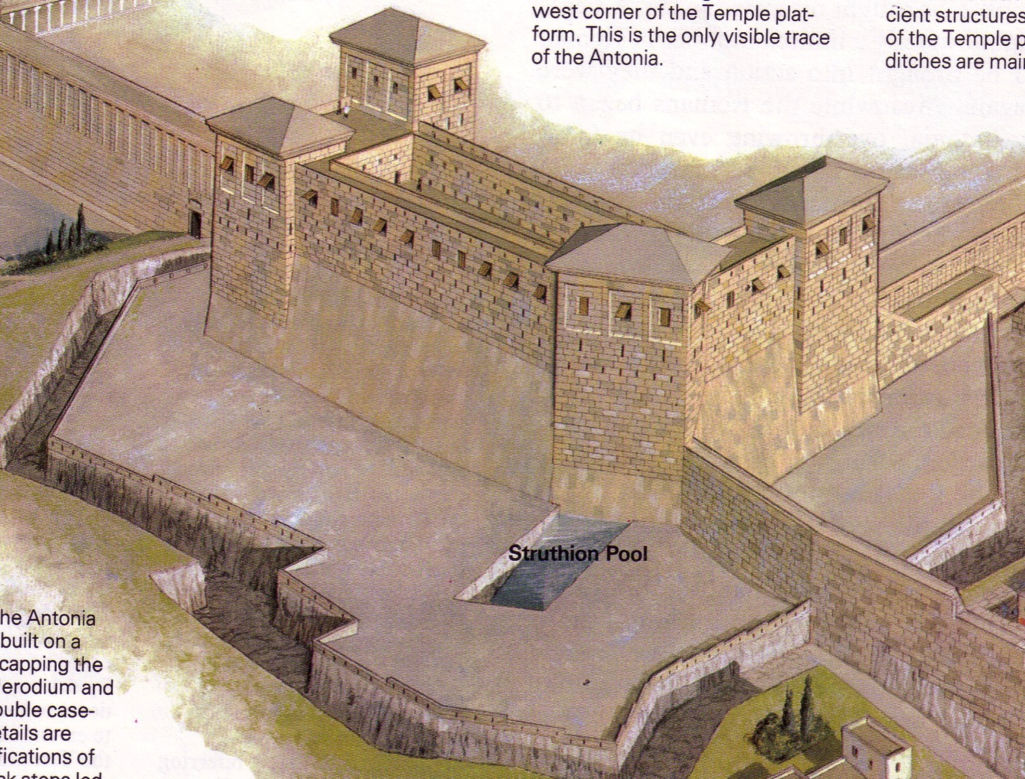
قلعة أنطونيا
Notes:
Of particular importance was this fortress with four towers overlooking the temple complex.

Slide 39
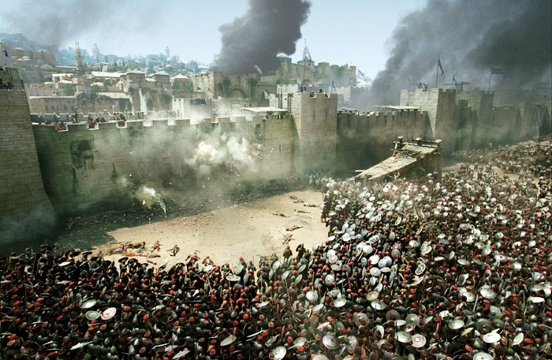
Antonia Fortress Leveled
Notes:
The Romans strategically focused their attack on the northern side to capture Antonia Fortress.

Slide 40
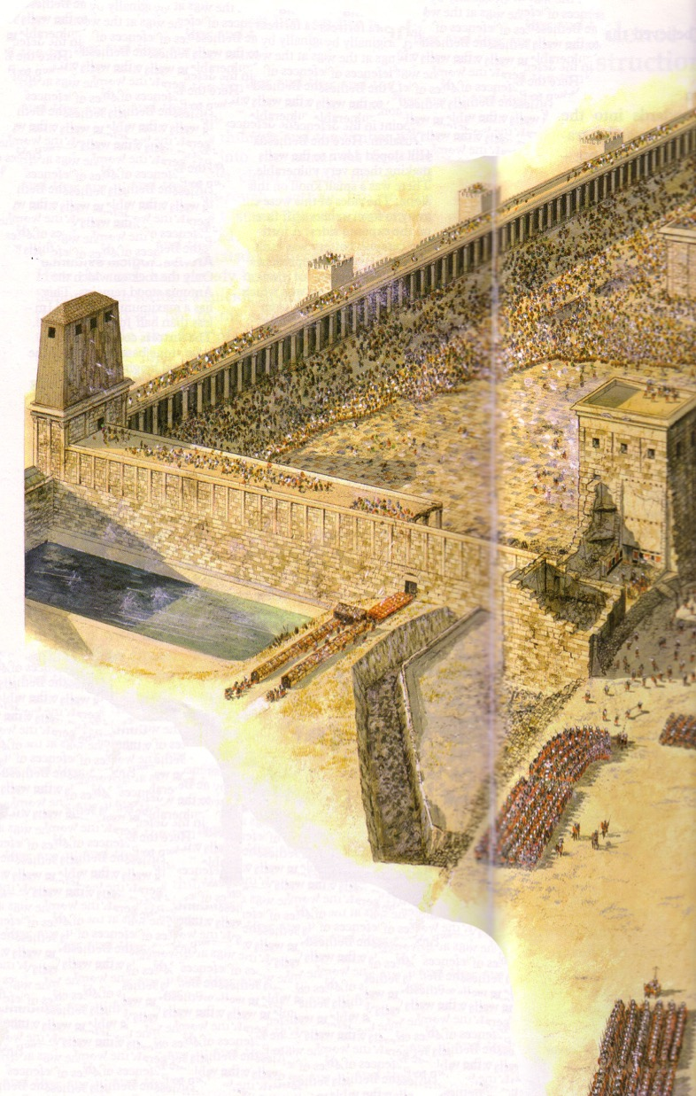
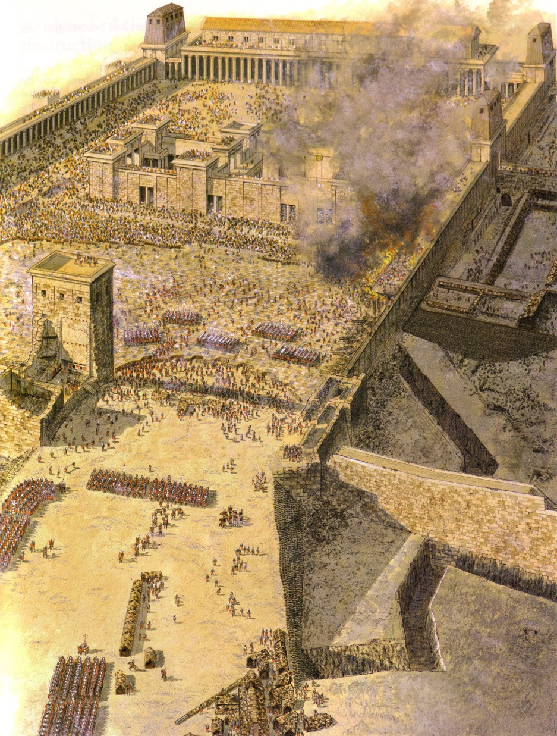
تسوية قلعة أنطونيا
Notes:
Finally it was leveled except for one tower that Titus used to command his troops.

Slide 41
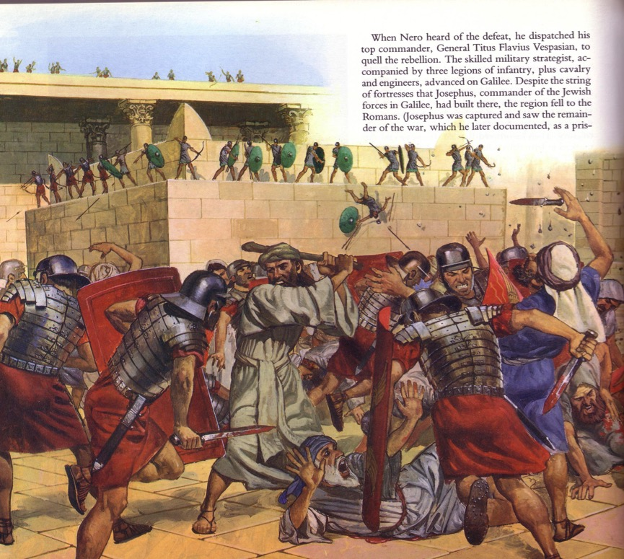
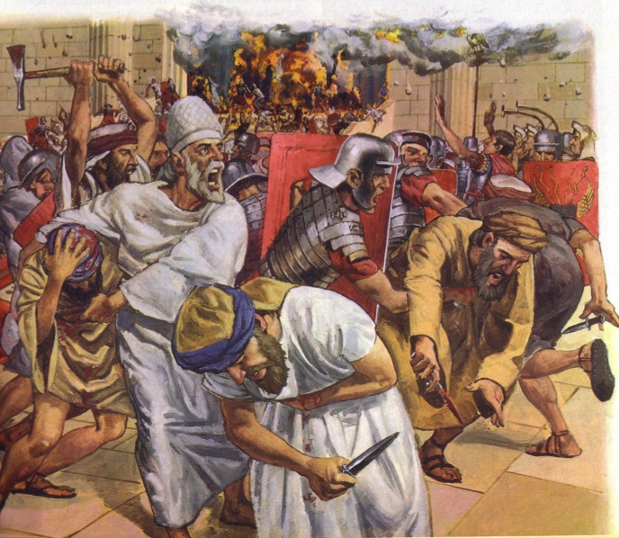
الهجوم على الهيكل
Notes:
The assault was an absolute bloodbath.
• This was especially against commoners and priests inexperienced in war to face the professional Roman soldiers, who killed them by the thousands.

Slide 42
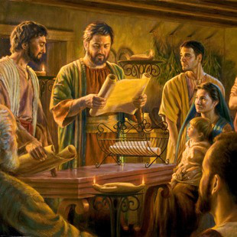
مؤمنو أورشليم
Notes:
But before this time, Jerusalem also had many Christians. This letter addressed believing Jews during these years of the Jewish-Roman War (AD 66-73).

Slide 43
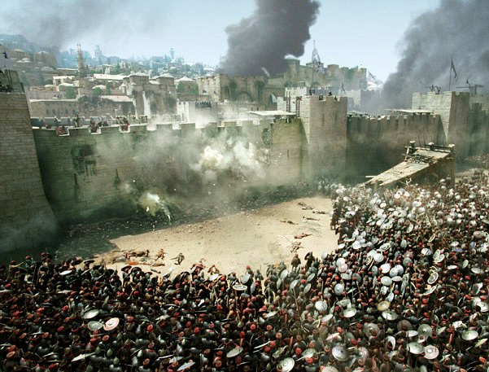
هل يجب على المؤمنين أن يبقوا و يحاربوا ؟
Notes:
The question for Christian Jews was simply this: Should they also join with their unbelieving Jewish brothers to fight against Rome? Should they risk their lives to preserve the obsolete temple system instead of persevering in their belief in a risen Savior?

Slide 44
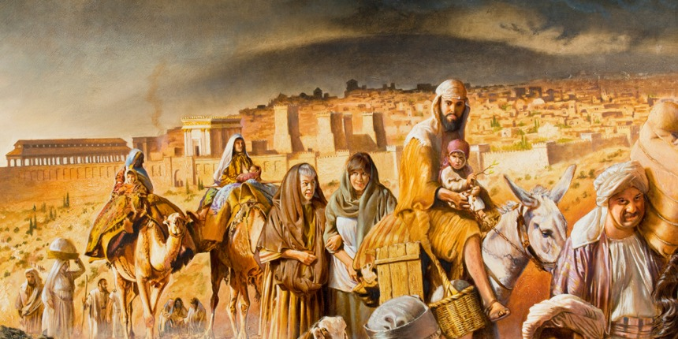
هروب مؤمني أورشليم
Notes:
The believers left Jerusalem before Rome destroyed it in AD 70.

Slide 45
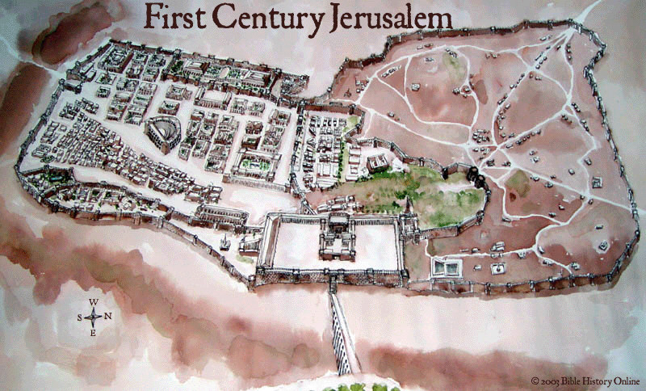

أورشليم في القرن الأول
Notes:
No Christian was left in the city—but would these readers go with them?

Slide 46
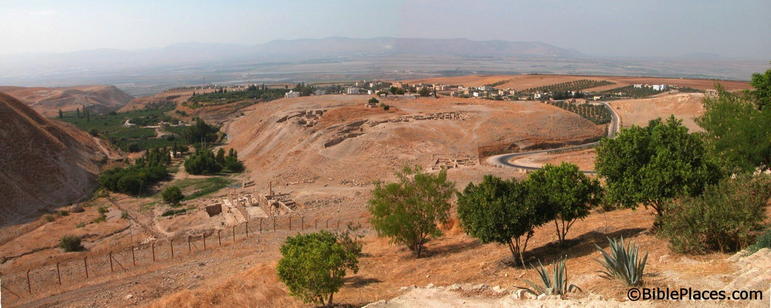
ما الذي حدث للمؤمنين في أورشليم ؟
حصلوا على رؤيا تخبرهم أن يحتموا في طبقة فحل
طبقة فحل
أورشليم
Notes:
• The church historian Eusebius says that God gave a revelation.
• So they left Jerusalem, crossed over into modern-day Jordan, and settled in Pella.
• This peaceful city has the same name today.
________
"Pella/Pehel is not mentioned explicitly in the Bible but it was prominent in biblical times. In the days of the judges, it led a rebellion against Egypt which was crushed by Pharaoh Seti I. In NT days, Pella was the site where Christians sought refuge during the Jewish Revolt against the Romans in 66-70 A.D. Eusebius records that the Jewish believers fled here in obedience to a revelation, which some correlate with Jesus' words in Matthew 24:16. This photo views the tell from the east. Several Byzantine churches have been excavated as well as a building believed to be a Late Bronze temple. The Jordan Rift and the mountains of Israel are visible in the background.” —Todd Bolen, BIblePlaces.com
___________
https://en.wikipedia.org/wiki/Flight_to_Pella
Accessed 29 Oct 2023
Ancient sources
The people of the Church in Jerusalem were commanded by an oracle given by revelation before the war to those in the city who were worthy of it to depart and dwell in one of the cities of Perea which they called Pella. To it those who believed on Christ traveled from Jerusalem, so that when holy men had altogether deserted the royal capital of the Jews and the whole land of Judaea…"
— Eusebius, Church History 3, 5, 3
This heresy of the Nazoraeans exists in Beroea in the neighbourhood of Coele Syria and the Decapolis in the region of Pella and in Basanitis in the so-called Kokaba (Chochabe in Hebrew). From there it took its beginning after the exodus from Jerusalem when all the disciples went to live in Pella because Christ had told them to leave Jerusalem and to go away since it would undergo a siege. Because of this advice they lived in Perea after having moved to that place, as I said."
— Epiphanius, Panarion 29,7,7-8
For after all those who believed in Christ had generally come to live in Perea, in a city called Pella of the Decapolis of which it is written in the Gospel that it is situated in the neighbourhood of the region of Batanaea and Basanitis, Ebion's preaching originated here after they had moved to this place and had lived there."
— Epiphanius, Panarion 30, 2, 7
So Aquila, while he was in Jerusalem, also saw the disciples of the disciples of the apostles flourishing in the faith and working great signs, healings, and other miracles. For they were such as had come back from the city of Pella to Jerusalem and were living there and teaching. For when the city was about to be taken and destroyed by the Romans, it was revealed in advance to all the disciples by an angel of God that they should remove from the city, as it was going to be completely destroyed. They sojourned as emigrants in Pella, the city above mentioned in Transjordania. And this city is said to be of the Decapolis."
— Epiphanius, On Weights and Measures 15
References
G. Uhlhorn, "Ebionites", in: A Religious Encyclopaedia or Dictionary of Biblical, Historical, Doctrinal, and Practical Theology, 3rd ed. (edited by Philip Schaff), p. 684–685 (vol. 2). O. Cullmann, "Ebioniten", in: Religion in Geschichte und Gegenwart, p. 7435 (vol. 2). van Houwelingen, P. H. R. (2003). "Fleeing forward: The departure of Christians from Jerusalem to Pella" (PDF). Westminster Theological Journal. 65. Archived from the original (PDF) on April 3, 2015.
Todd Bolen: "Pella/Pehel is not mentioned explicitly in the Bible but it was prominent in biblical times. In the days of the judges, it led a rebellion against Egypt which was crushed by Pharaoh Seti I. In NT days, Pella was the site where Christians sought refuge during the Jewish Revolt against the Romans in 66-70 A.D. Eusebius records that the Jewish believers fled here in obedience to a revelation, which some correlate with Jesus' words in Matthew 24:16. This photo views the tell from the east. Several Byzantine churches have been excavated as well as a building believed to be a Late Bronze temple. The Jordan Rift and the mountains of Israel are visible in the background."

Slide 47
تحذير 3
رفض المسيح قد يؤدي إلى
الموت الجسدي
(5: 11-6: 20)
Notes:
Christians who later reject Jesus can die before their time

Slide 48
تحذير 4
خطايا العمد قد تؤدي إلى
الموت الجسدي
(10: 26-31)
Notes:
Christians who deliberately turn away from Jesus can die before their time.
Believers who purposely reject Christ can enter heaven earlier than God intended.

Slide 49
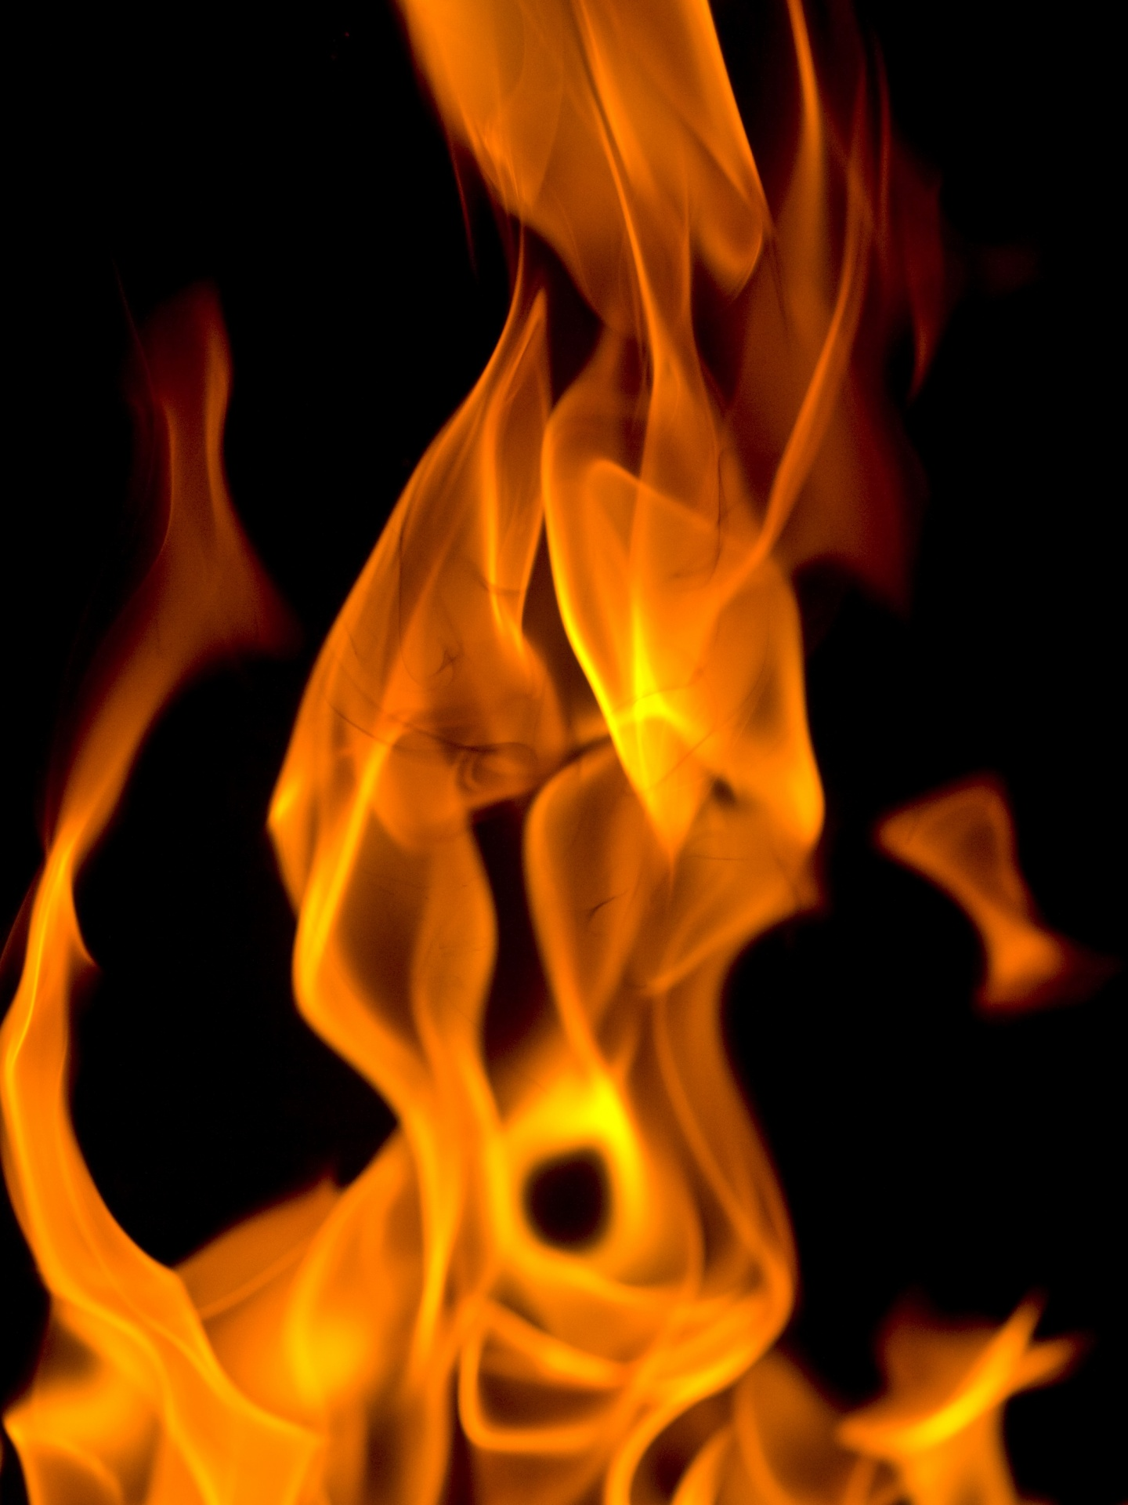
فإنه إن أخطأنا باختيارنا بعدما أخذنا معرفة الحق لا تبقى بعد ذبيحة عن الخطايا بل قبول دينونة مخيف و غيرة نار عتيدة أن تأكل المضادين
(عب 10: 26-27)
هل هؤلاء
الأشخاص
مؤمنون ؟

Slide 50
لماذا المؤمنون ؟
تشير الرسالة بشكل متكرر إلى القراء كمؤمنين
تمسكوا بإقرار الرجاء في المسيح (10: 23)
عليهم أن يبنوا بعضهم بعضاً في الإيمان (10: 24-25)
حصلوا على معرفة الحق (10: 26)
قد يخطئ الكاتب نفس هذه الخطايا (10: 26)
لقد تقدسوا (10: 29)
تألموا بأمانة لأجل المسيح (10: 32-34)
كان لهم ثقة بالرب (10: 35)
احتاجوا أن يثبتوا في الإيمان (10: 36)
اعتبروا من الأبرار (10: 38)
Notes:
There are many verses in Hebrews 10 that show the readers to be believers in Christ.

Slide 51
النار
26 فإنه إن أخطأنا باختيارنا بعدما أخذنا معرفة الحق لا تبقى بعد ذبيحة عن الخطايا 27 بل قبول دينونة مخيف و غيرة نار عتيدة أن تأكل المضادين (عب 10: 26-27)
نار جهنم ؟
لا، نار أورشليم
Notes:
God’s judgment on these readers if they turned away would be “the raging fire that will consume his enemies.”
• Most commentaries claim that this means the readers would go to hell.
But is this hell fire? If so, that would mean these Christians would then go to hell! This is against all that the NT teaches about believers having eternal life.
• No, it refers to Jerusalem fire! Their salvation was secure—but their apostasy would lead to being killed along with the unbelieving Jews who stayed in Jerusalem to protect the temple!

Slide 52
عبرانيين 8: 13
فإذ قال جديداً عتق الأول و أما ما عتق و شاخ فهو قريب من الإضمحلال
العتيق
33 م
كتابة العبرانيين
67-68 م
الإضمحلال
70 م
Notes:
Hebrews 8:13 appropriately warns that the old covenant would soon disappear in the temple destruction.
• The arrival of the new covenant in Jesus meant that God no longer wanted us to follow the old covenant under Moses. It became obsolete at the death of Christ in AD 33.
• Hebrews was written about 35 years later when the sacrificial system still operated. I guess someone sewed the veil of the temple back together!
• The writer then amazingly wrote that this obsolete old covenant would soon disappear—the event that happened in AD 70 with the destruction of the temple and the sacrificial system. Since then a Jew has not been able to offer sacrifices even if he wanted to do so.

Slide 53
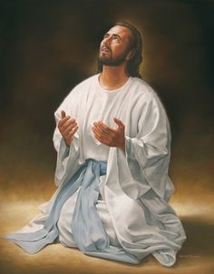
لا تقنع الله أن يأتي بك إلى السماء باكراً
الفكرة الرئيسية
Notes:
Turning away from Jesus—apostasy—can result in the Lord not only taking away our rewards but also taking away our lives!

Slide 54
تحذير 3
رفض المسيح قد يؤدي إلى
الموت الجسدي
(5: 11-6: 20)
Notes:
Christians who later reject Jesus can die before their time

Slide 55
تحذير 4
خطايا العمد قد تؤدي إلى
الموت الجسدي
(10: 26-31)
Notes:
Christians with willful sin Jesus can die before their time

Slide 56
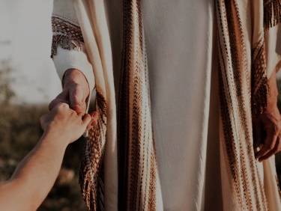
لقد حدث ذلك
موت حنانيا و سفيرة
(أع 5: 1-11)
الإساءة لمائدة الرب
(1 كو 11: 30)
بعض الخطايا تؤدي للموت
(1 يو 5: 16-17)
البعض يخلص كما بنار
(1 كو 3: 15)
Notes:
We already saw in message 2 how God disciplined believers with death for the serious sin of apostasy.

Slide 57
المشكلة في الملصقات
266ت
هل يجب أن نكون واحداً من الإثنين ؟
المصلحين
أو
الأرمينيين
كثيرون سيسقطون
فقدان الخلاص
نقاط الضعف
الضمان الأبدي
حقيقة الإرتداد
نقاط القوة
نظرية الشركاء لديها كل نقاط القوة و لا نقاط ضعف فيها
Notes:
The Partakers View sees death for apostasy while maintaining eternal security.

Slide 58

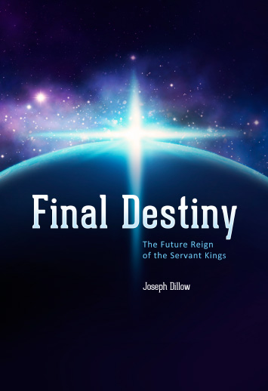
الحكم المستقبلي للملوك الخدام
جودي ديلو هو المؤلف الرئيسي لنظرة الشركاء
المصير النهائي
الحكم المستقبلي للملوك الخدام
جوزيف ديلو
Notes:
• There is a future reign of the Servant Kings—that is you and me!
• Our future inheritance is well articulated by Joseph Dillow in his massive book, Final Destiny
• Dillow is the key author of what he calls the Partakers View.
This view explains inheritance in the OT.
Inheritance in the OT was of two types:
All Israelites who believed in the LORD would have God as their inheritance—or be saved.
But only those Israelites that obeyed the LORD wholeheartedly would inherit Canaan—or be rewarded.
Dillow calls this view the Partakers View based on Hebrews 3:14 that promises believers who persevere to be partakers or sharers with Jesus in his future rule.
___________
Common-257
OS-04-Numbers-148
OS-06-Joshua-175
NS-19-Hebrews-58, 186, 448
SA-15-Inheritance-35, 173
TP-01-Our Inheritance OT Summary-35
TP-03-Our Inheritance Hebrews Warnings-56

Slide 59
التطبيق : غادر أورشليم
لذلك يسوع أيضاً لكي يقدس الشعب بدم نفسه تألم خارج الباب
(عب 13: 12)
فلنخرج إذاً إليه خارج المحلة حاملين عاره
(عب 13: 13)
Leen & Kathleen Ritmeyer, "Akeldama: Potter's Field or High Priest's Tomb?" BAR 20 (Nov/Dec 94): 34
Notes:
The application to leave Jerusalem is in Hebrews 13.

Slide 60
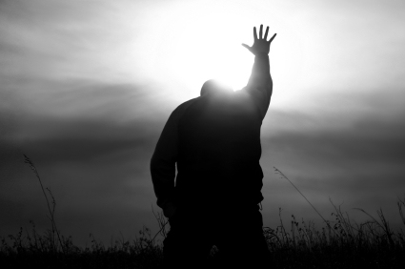
قدم نفسك له
Notes:
The application for you is to commit yourself to him (leave sin).

Slide 61
Black

Slide 62


الخلاصBibleStudyDownloads.org
أحصل على العرض التقديمي و النص مجاناً

